Slide 1
LoRaWAN FINAL EVALS NYPD+ Inmates
SAMKIT JAIN – 2022102062

Slide 2
agenda
LoRA | LoRaWAN 4
Components and Requirement 11
Join procedure and Classes 16
Localisation 24
Conclusion and Future Scope 25

Slide 3
PROBLEM STATEMENT
Objective it to make a DOG TRACKER using LoRa and LoRaWAN protocol .
We also tried to LOCALISE it using a basic triangulation method by calculating linear distances calculated using RSSI.

Slide 4
LoRa AND LORAWAN

Slide 5
LoRa and LoRaWAN
LoRa - which stands for long range, is a wireless technology widely acknowledged for its ability to send small amount of data over wide distances .
LoRaWAN is the network protocol that links the lora signal (sensor data) to the application.
To put it simply, LoRa is the radio signal that carries the data, and LoRaWAN is the communication protocol that controls and defines how that data is communicated across the network.

Slide 6
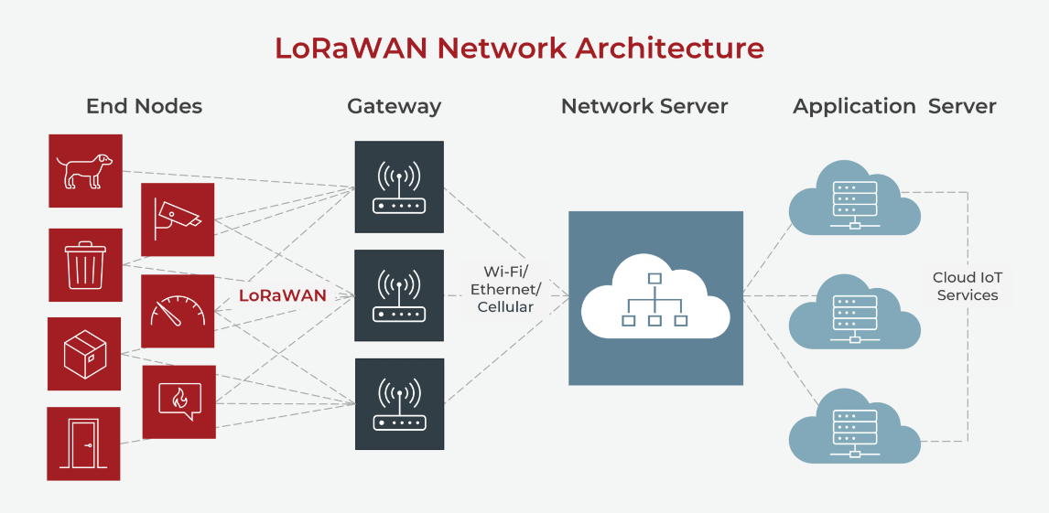
Working of LoRaWAN

Slide 7
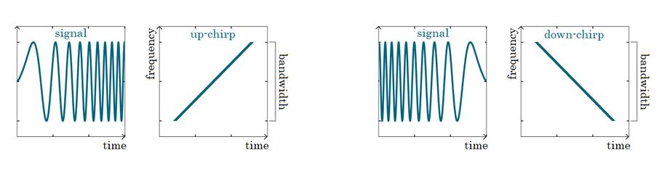
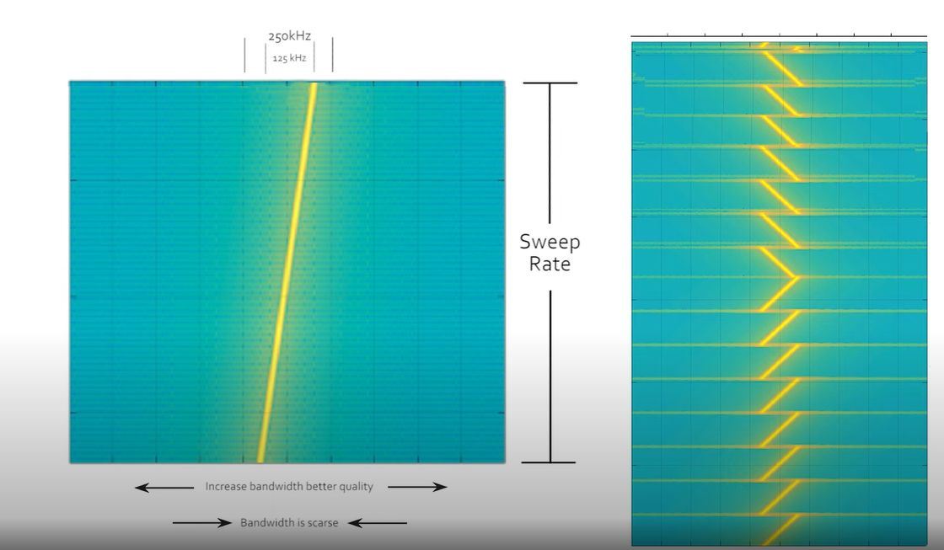
CHIRP SPREAD SPECTRUM
1. Uses up-chirp and down –chirp to send data.
2.Different bits are send by altering the sweep rate and the range in which it sweeps (Bandwidth)
3.Also , LoRa devices follow Aloha protocol (Just wake up and communicate)
4. Orthogonality of the SF signals

Slide 8
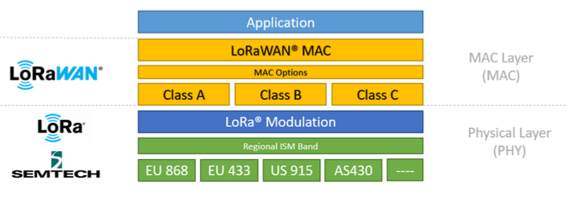
TECHNOLOGY STACK
1 . LoRa is the physical (PHY) layer, i.e., the wireless modulation used to create the long-range communication link.
2. LoRaWAN is an open networking protocol that delivers secure bi-directional communication, mobility, and localization services standardized and maintained by the LoRa Alliance.

Slide 9
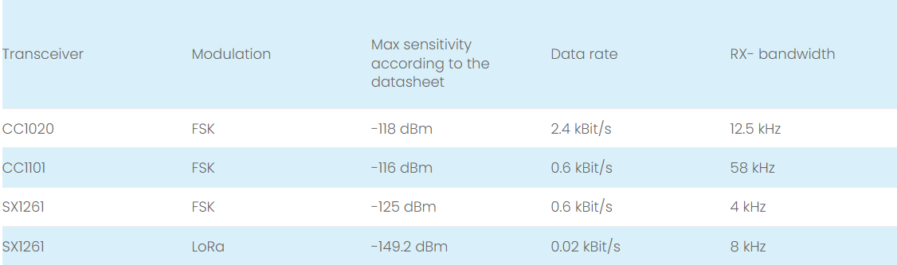
WHY LoRa ? LoRa MODULATION vs FSK
LoRa achieves at least a 24dB better maximum sensitivity than with the best FSK transceiver (SX1261) .
It is also noticeable that the maximum LoRa sensitivity is achieved with an extremely slow data rate of only 0.02 kbit / s.

Slide 10
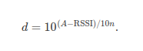
RSSI
Instead of using GPS to locate the position of a beacon , we use RSSI method .
Received Signal Strength Indicator (RSSI) is one of the range-based techniques in localization. The longer distance resulted in the signals travel with greater attenuation .
The linear distance can be obtained from RSSI using the below formula
1.A is the standard RSSI value I.e, value corresponding to 1m distance
2.RSSI is the received RSSI value from the beacon
3. 10n in the denominator is the environmental factor .

Slide 11
COMPONENTS AND REQUIREMENTS

Slide 12
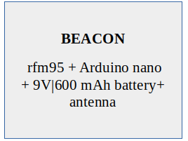
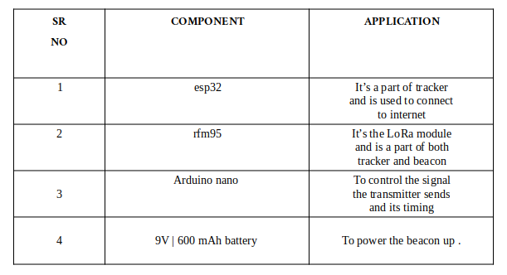
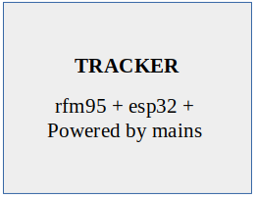
COMPONENTS REQUIRED

Slide 13
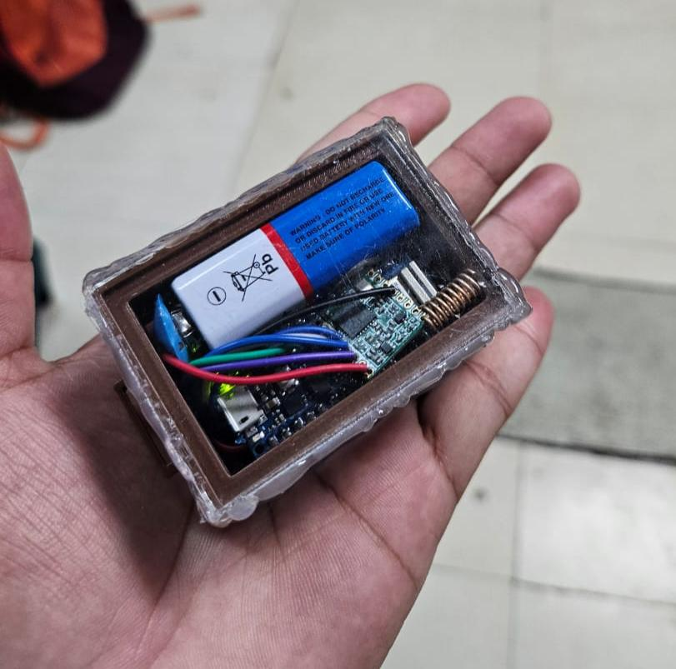
WORKING OF COMPONENTS
1 . BEACON :
It goes on the dog collar which pings to the receiver every 5 secs which is further transmitted to the gateway .
The pinging of beacon to receiver – LoRa MODULATION
Consists of rfm95 and arduino nano which is powered by
a 9V battery .
It is shielded by a 3D modelling box which is compact enough to fit
all the components and still be less than our palm size !!
This makes it compact and robust .

Slide 14
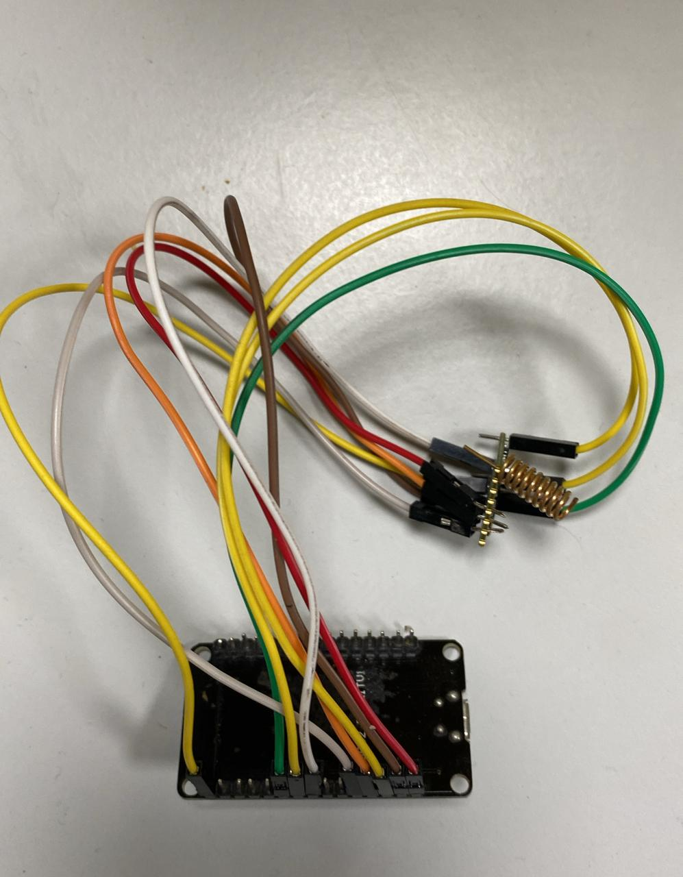
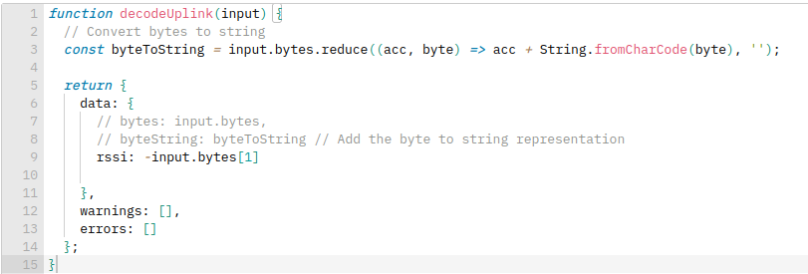
WORKING OF COMPONENTS
2 . TRACKER :
Shown on the right is the stationary tracker which pings to the gateway every 10 secs using LORaWAN .
Consists of rfm95 and esp32 which is powered by mains and can be placed
anywhere within the range of the dog beacon.
It receives the RSSI value of the beacon and sends that to the gateway by
changing the sendjob and payload formatting .

Slide 15
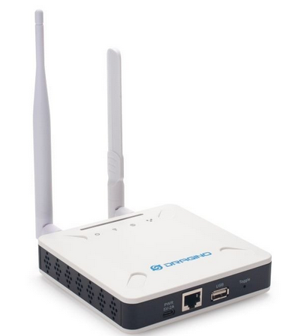
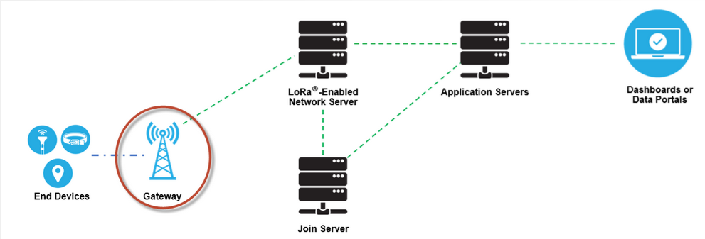
WORKING OF COMPONENTS
3. GATEWAY :
A LoRaWAN gateway receives LoRa modulated RF messages from any end device in hearing distance and forwards these data messages to the LoRaWAN network server (LNS), which is connected through an IP backbone.

Slide 16
JOIN PROCEDURE and CLASSES

Slide 17
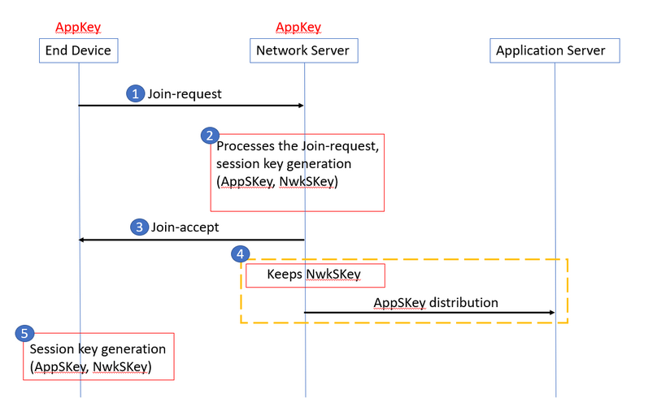
LoRaWAN – OTAA vs ABP
Over-The-Air-Activation (OTAA) - . 1.Devices perform a join procedure with the network, during which a dynamic device address is assigned and security keys are negotiated with the device.
Activation By Personalization (ABP) 1.Requires hardcoding the keys and address .
2.ABP is less secure than OTAA

Slide 18
LoRaWAN – JOIN PROCEDURE
The join procedure requires two MAC messages to be exchanged between the end device and the Network Server:
Join-request - from end device to the Network Server
Join-accept - from Network Server to the end device
1.Before activation, the AppEUI, DevEUI, and AppKey should be stored in the end device.
2.The AppKey is an AES-128 bit secret key known as the root key.
3.The AppEUI and DevEUI are not secret and are visible to everyone

Slide 19
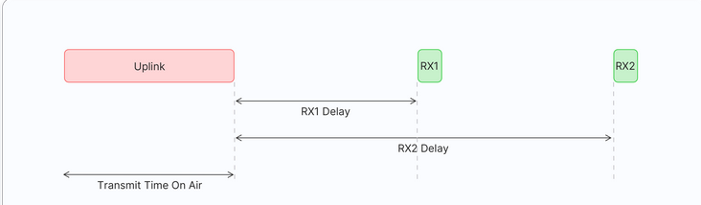
CLASS – A DEVICES
1.Once the uplink transmission is completed, the device opens two short receive windows for receiving downlink messages from the network.
2.There is a delay between the end of the uplink transmission and the start of each receive window, known as RX1 Delay and RX2 Delay, respectively
3. If the network server does not respond during these two receive windows, the next downlink will be scheduled immediately after the next uplink transmission.

Slide 20
WHY CLASS – A ?
1.Class A end devices have very low power consumption. Therefore, they can operate with battery power. T
2.They spend most of their time in sleep mode and usually have long intervals between uplinks.
3.Additionally, Class A devices have high downlink latency, as they require sending an uplink to receive a downlink.

Slide 21
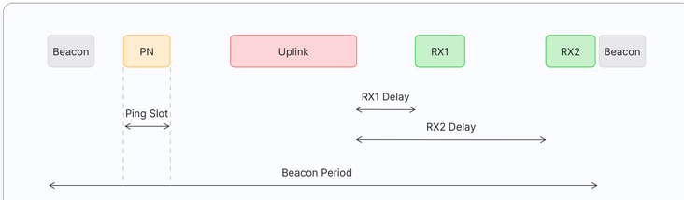
CLASS – B
1. Class B devices periodically opens a receive windows called ping slots to receive downlink messages.
2.The network broadcasts a time-synchronized beacon periodically through the gateways, which is received by the end devices. These beacons provide a timing reference for the end devices, allowing them to align their internal clocks with the network
3.The time between two beacons is known as the beacon period.

Slide 22
CLASS – A vs CLASS -B
1.Class B end devices have low latency for downlinks compared to Class A end devices because they periodically open ping slots.
2. Class B devices are often battery powered.
3.The battery life is shorter in Class B compared to Class A because the devices spend more time in active mode due to receiving beacons and having open ping slots.
4.Because of the low latency for downlinks, Class B mode can be used in devices that require medium-level critical actuation, such as utility meters.

Slide 23
PROGRESS SINCE MIDEVALS
1 . Setting up tracker using esp32 and connecting to gateway .
2 . 3D modelling and making the beacon robust .
3 . Sending the beacon’s RSSI by changing sendjob and payload formatting .
4 .Localisation using triangular formulation .
5 . DEPLOYMENT

Slide 24
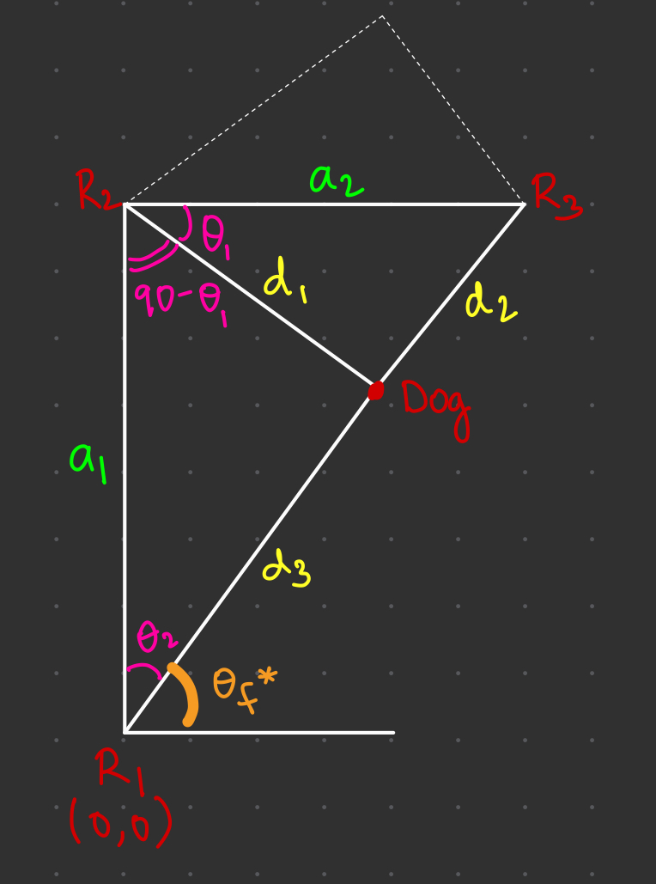
LOCALISATION
1. The distances a1 and a2 are predetermined as they represent the placement of the receivers, which is determined according to our preferences .
2. The distance d1 , d2 and d3 are found using the RSSI value send by the beacon which can be used to find the linear distance as discussed in the RSSI slide .
3. We calculate θ1 to know the position of the dog i.e which side is the dog on (the dotted or the marked position).
4. We can calculate θf using the cosine rule (all the sides of the triangle are known) and then find θf = 90 - θ2
5. The corresponding (x,y) can be found using this θf value .

Slide 25
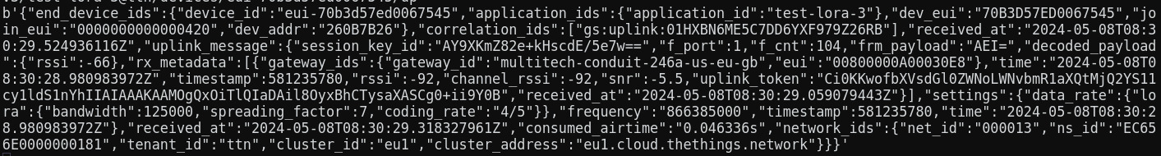
GETTING DATA FROM GATEWAY
1.We used a nodejs script to obtain data from the gateway as shown above .
2 . We can obtain the RSSI value from these and compute the distance and then localise it accordingly .

Slide 26
PROBLEMS FACED and FIXES
We faced multiple problems along the course of the project but listed below are a few major ones :
1.Difference in the size of the pins of MC’s and the rfm95 : We addressed the size difference between MC's pins and the RFM95 by carefully soldering and fitting them closely together, ensuring the wires didn't touch.
2.We encountered significant temperature sensitivity with the RFM module during soldering. To prevent any adverse effects on its functionality, we regularly monitored and regulated the soldering temperature throughout the process.
3. SIZE OF THE BEACON : Even after the addition of the 9V battery , our goal was to keep the beacon as compact as possible which resulted in soldering and placing each component over an other and still make sure it works .

Slide 27
CONCLUSIONS and FUTURE SCOPE
We were able to implement the LoRa and LoRa modualation using rfm95 and microcontrollers and connect to the gateway .
For future scope : we wanted to improve our localisation method by considering error in the distance calculation while estimating the location – LLS - Linear Least Square .
We can also set up more receiver and future expand the network and locate the dog with much more precision .

Slide 28
THANK YOU !!

